Slide 1
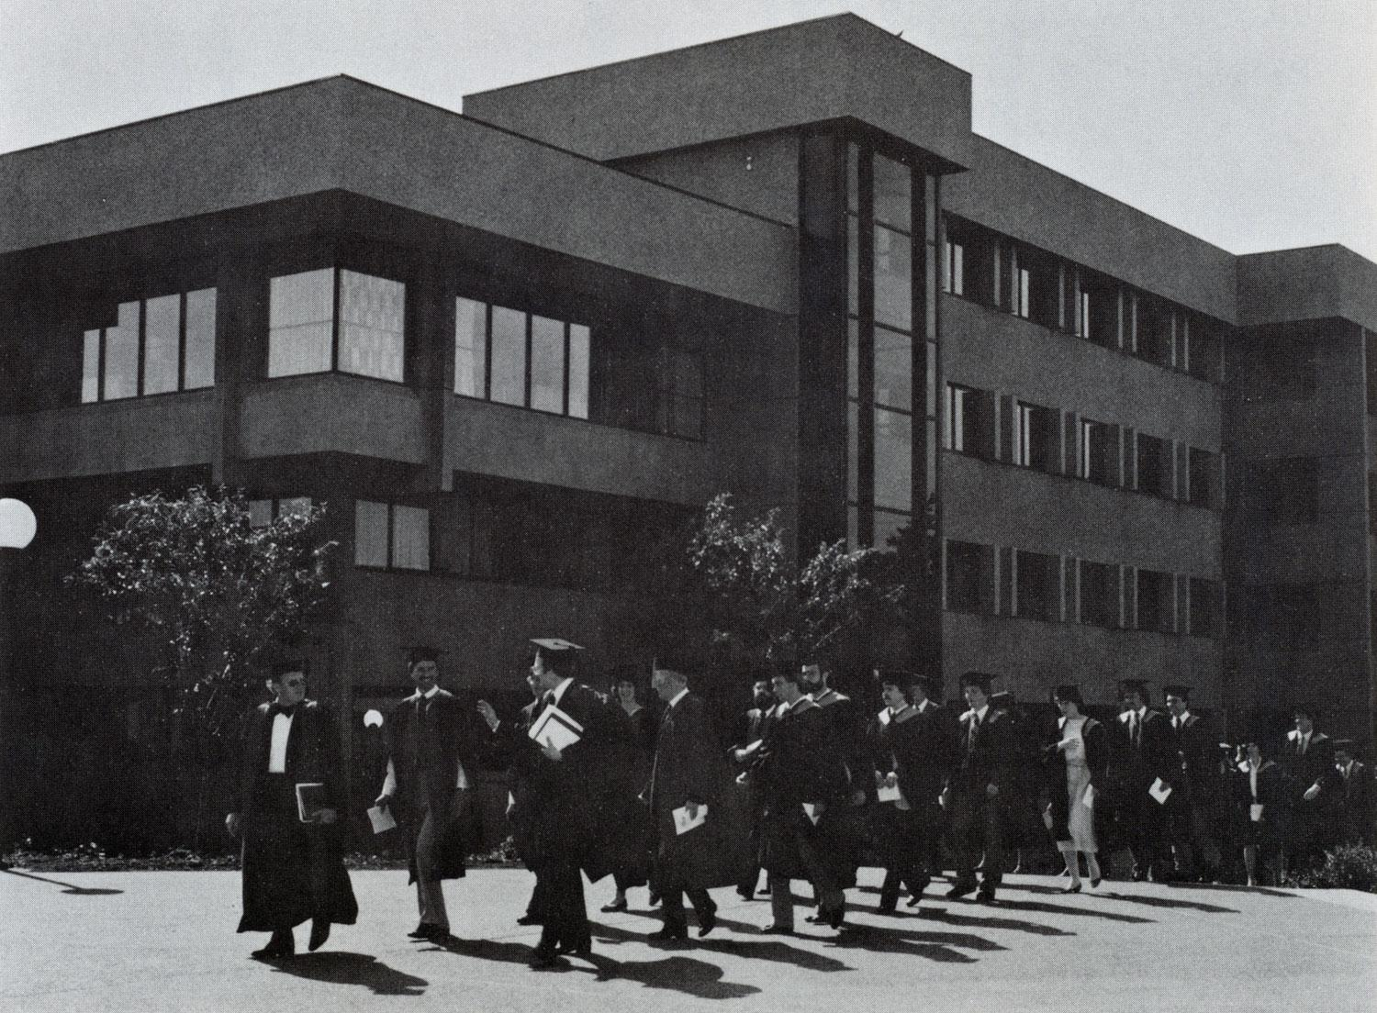
Modernizing Clearihue with Energy-Saving Technology
Devroop Banerjee Alina Chin Peter Kihaile Thomas Watkin
Source: UVAC
Notes:
Topic + Purpose: explain the work we’ve done for our final project, so you can assess our progress and any setbacks

Slide 2
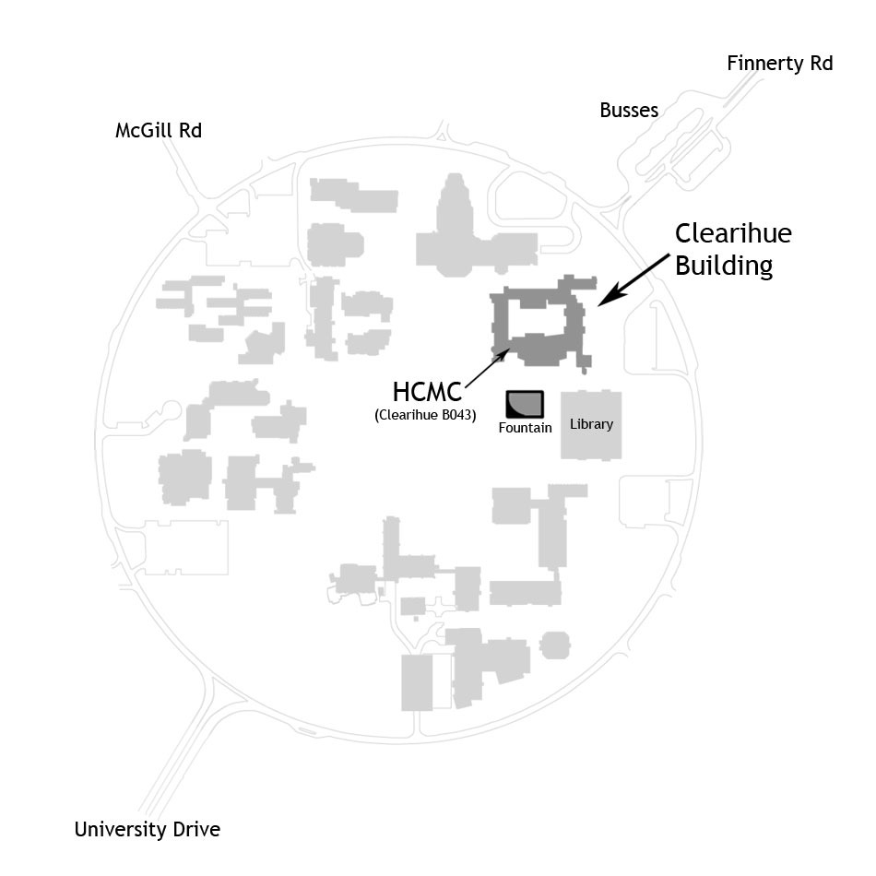
Overview
Background
Methods
Problems & Expected Outcomes
Timeline
Work Completed
Work Remaining
Conclusion
Source: UVic HCMC
Notes:
What our project is, How we’re going to implement it, timeline When we’ve set our goals, and What we’ve completed and what we still have to do

Slide 3
Background
UVic Energy Action Plan goals for 2019
Different infrastructures, different needs
Older buildings - not LEED Gold rated
Clearihue electricity consumption: 2.5 million kWh (2015)
Goal: Research how to reduce Clearihue’s energy consumption
Benefits: No need to wait for a major renovation or a replacement building
Notes:
Need statement - UVic needs to cut down on wasted electricity (-8% overall by 2019)
Goal - research how to reduce energy consumption
Benefits - reduce electricity costs & wasted electricity before 2019

Slide 4
Methods
General Research: Collect raw data about Clearihue’s energy usage from David Adams and administrative services.
Surveying: Survey students at Clearihue and observe their occupancy patterns.
Analysis: the data to identify the most essential changes Clearihue has to undergo and how much energy it saves in the long run.
Output: Write a report based on our findings and ideas.

Slide 5
Problems encountered & Expected outcomes
The only problems the team has run into is a late start, which we are making up for through online collaboration.
Although drawing conclusions and making promises at this stage would be unwise, it is clear that our ideas are feasible. Our calculations so far support our claim.
We expect to complete the project by the deadline (Dec. 4).
A reduction of our research and survey time has reduced our expected budget.

Slide 6
Timeline
Behind schedule by nearly a week.
Recently received data from David Adams which speeds things up.
Minimize the damage by reducing the amount of time dedicated to data collection/observation and processing by 15%.
Table 1: Updated Timeline
Tasks | 20th - 25th Nov | 26th - 30th Nov | 1st - 4th Dec
Background Research
Real time Observation
Conduct Surveys
Data Analysis
Draft Report
Edit and Proofread Report
Complete Report

Slide 7
Work Completed
Discussing and refining the problem statement (Nov. 14)
Collection of raw data as a part of background research (Nov. 17)
Observe Clearihue Light Usage (Nov. 23)
Brainstorming for stable and permanent solutions to improve Clearihue’s power consumption (Nov. 17)
Proposals, team reports and progress reports.

Slide 8
Work Remaining
Surveys and observations to find how much time students spend in the building. When are they in the building? Do they switch off lights? (Nov. 25)
Propose energy-saving policies for the building’s occupants. (Nov. 30)
Write a report based on our findings. (Dec. 2)
Edit and proofread the report to finalize it. (Dec. 4)

Slide 9
Projected Savings
~1400 bulbs by initial survey count
At 18 watts per bulb over 8 hours gives us 144 Wh per day per bulb
144 * 365 days = 52.56kWh per year
52.56kWh = $6 per year
~$8400 per year in total savings

Slide 10
Conclusion
As it stands, less than a week behind schedule, however we’re catching up in spite of being under a budget.
Not currently at a point to be making recommendations for Clearihue.
Timeline for plans must be condensed and we will coordinate our work better.
Each part of the project weaves into the next and that helps maintain cohesion.
Any suggestions/advice?

